Slide 1
Demographic Study Summary
Preston Smith
Principal Owner
Business Information Services, LLC

Slide 2
Our credentials
Why we can give an opinion
Completed more than 200 studies and school district projects in 15 states since 2004.
  Master’s in Public Administration and Statistics
  Our projections vary by an average of only 0.3% per year.
  We have worked on redistricting projects as large as the state of West Virginia and also with more than 40,000 students.

Slide 3
Key Findings
Our analysis has 3 projection models, ranging from a 11 percent decrease during the next 10 years to a 19 percent decrease.

Slide 4
Key Findings
The projected decreases range from 3.4% in the 3rd grade to up to 38% in the 12th grade

Slide 5
Key Findings
We do not see the likelihood for enrollment growth because there are too many factors that can inhibit growth:
  Large and growing private school enrollment.
  Weak birth rate.
  Weak demographic trends for school-age populations.
  Very unaffordable housing for families.
  Weak relationship between new jobs and new enrollment.

Slide 6
Key Findings
Private education enrollment has increased
In 2011-12, the district had 1,582 private school students. In 2022-23, the district had 1,951, an increase of 23 percent. Statewide, the growth was only 15 percent.

Slide 7
Key Findings
Private education enrollment has increased
Our data vendor estimates that the district’s market share of available school-age students has fallen from 89% to 70.5%. We estimate there are more than 5,300 private school students within 15 miles at 38 schools.

Slide 8
Key Findings
38% of all households in the Nashua School District are non-family households. That is an extremely high percentage.

Slide 9
Key Findings
If we take only the 62% of all households in the Nashua School District that are considered families, only 41% of those have any children.

Slide 10
Key Findings
Key Findings
A Decreasing Birth Rate
In 1995, there were 2,550 births in the district. Today there are 1,626, a decrease of 36 percent. This is the largest decline in any school district that we have seen anywhere in the country.

Slide 11
Key Findings
The number of children under 5 years old living in the district is expected to decrease by 4.6 percent between 2022 and 2032.

Slide 12
Key Findings
Our data vendor predicts a decrease of 666 school-age children by 2032 compared with today, a 4.8 percent decrease.

Slide 13
Key Findings
One demographic that is growing
Our data vendor predicts an increase of nearly 5,000 persons older than 60 years old during the next decade, an increase of 21.2 percent.

Slide 14
Key Findings
When new residents search for a school
When someone does research about where to enroll their children, this is what the see.
Niche.com
SchoolDigger.com

Slide 15
Key Findings
Just the opposite of what you’d expect
  From 2000 to 2010, the district’s population grew by 111 persons.
  But the district’s enrollment fell by 1,323 students.
  That means that for every 1 person who moved to the district, there were 11.9 fewer students enrolled.

Slide 16
Key Findings
No relationship between enrollment growth and new jobs
In most districts, when area employment increases, so does enrollment. Not the case in this district.

Slide 17
Key Findings
No relationships between enrollment growth and new construction
Since 2010, there has been an average of 50 residential units built in the district and an average decrease in the number of students of 76 per year.

Slide 18
Key Findings
Very unaffordable housing
As the Affordability Index gets lower, it means it is less likely that a person of average income can afford it. Single-family house prices have nearly doubled in the district since 2013.

Slide 19
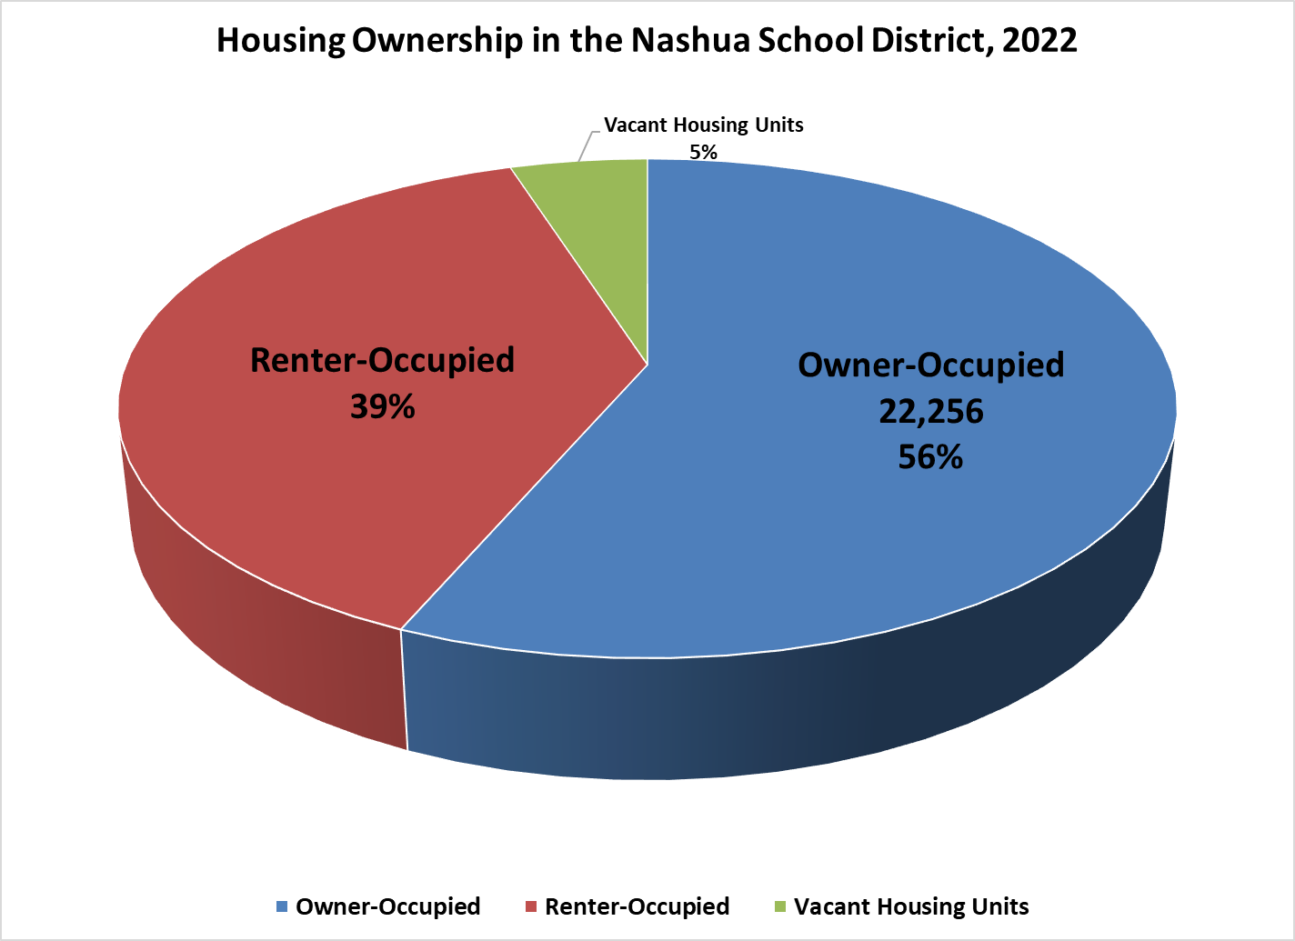
Key Findings
A high percentage of home renters
Most district we work in have a rental housing rate of about 20-25%. Nationwide, about 36% of all households are comprised of renters.

Slide 20
Key Findings
Very unaffordable housing
Only 2.3% of the students live in houses built within the last 10 years. Only about 11% live in houses valued more than $350,000. (The over-$500K housing would be nearly all apartments. )

Slide 21
Key Findings
Plenty of space for students
Sq. Footages from the New Hampshire Education Department Adopted Rule 6/2020
We estimate the district’s schools can hold 14,799 students. With a current enrollment of 9,849, that gives a utilization rate of 66%
https://www.education.nh.gov/sites/g/files/ehbemt326/files/inline-documents/sonh/ed321-buildingaid.pdf

Slide 22
Key Findings
Plenty of space for students
The red bars are the estimated capacities and the blue bars are what the buildings actually held in 1999-2000. There were some temp classrooms then, but also some capacities have increased in 20 years.

Slide 23
Key Findings
Plenty of space for students
We used four different methods to calculate elementary school capacity. The calculations were consistent. Then we took an average of all four methods.

Slide 24
Key Findings
6 Schools Could be Closed
With 6 schools closed, the district-wide capacity would still have nearly 700 student surplus.

Slide 25
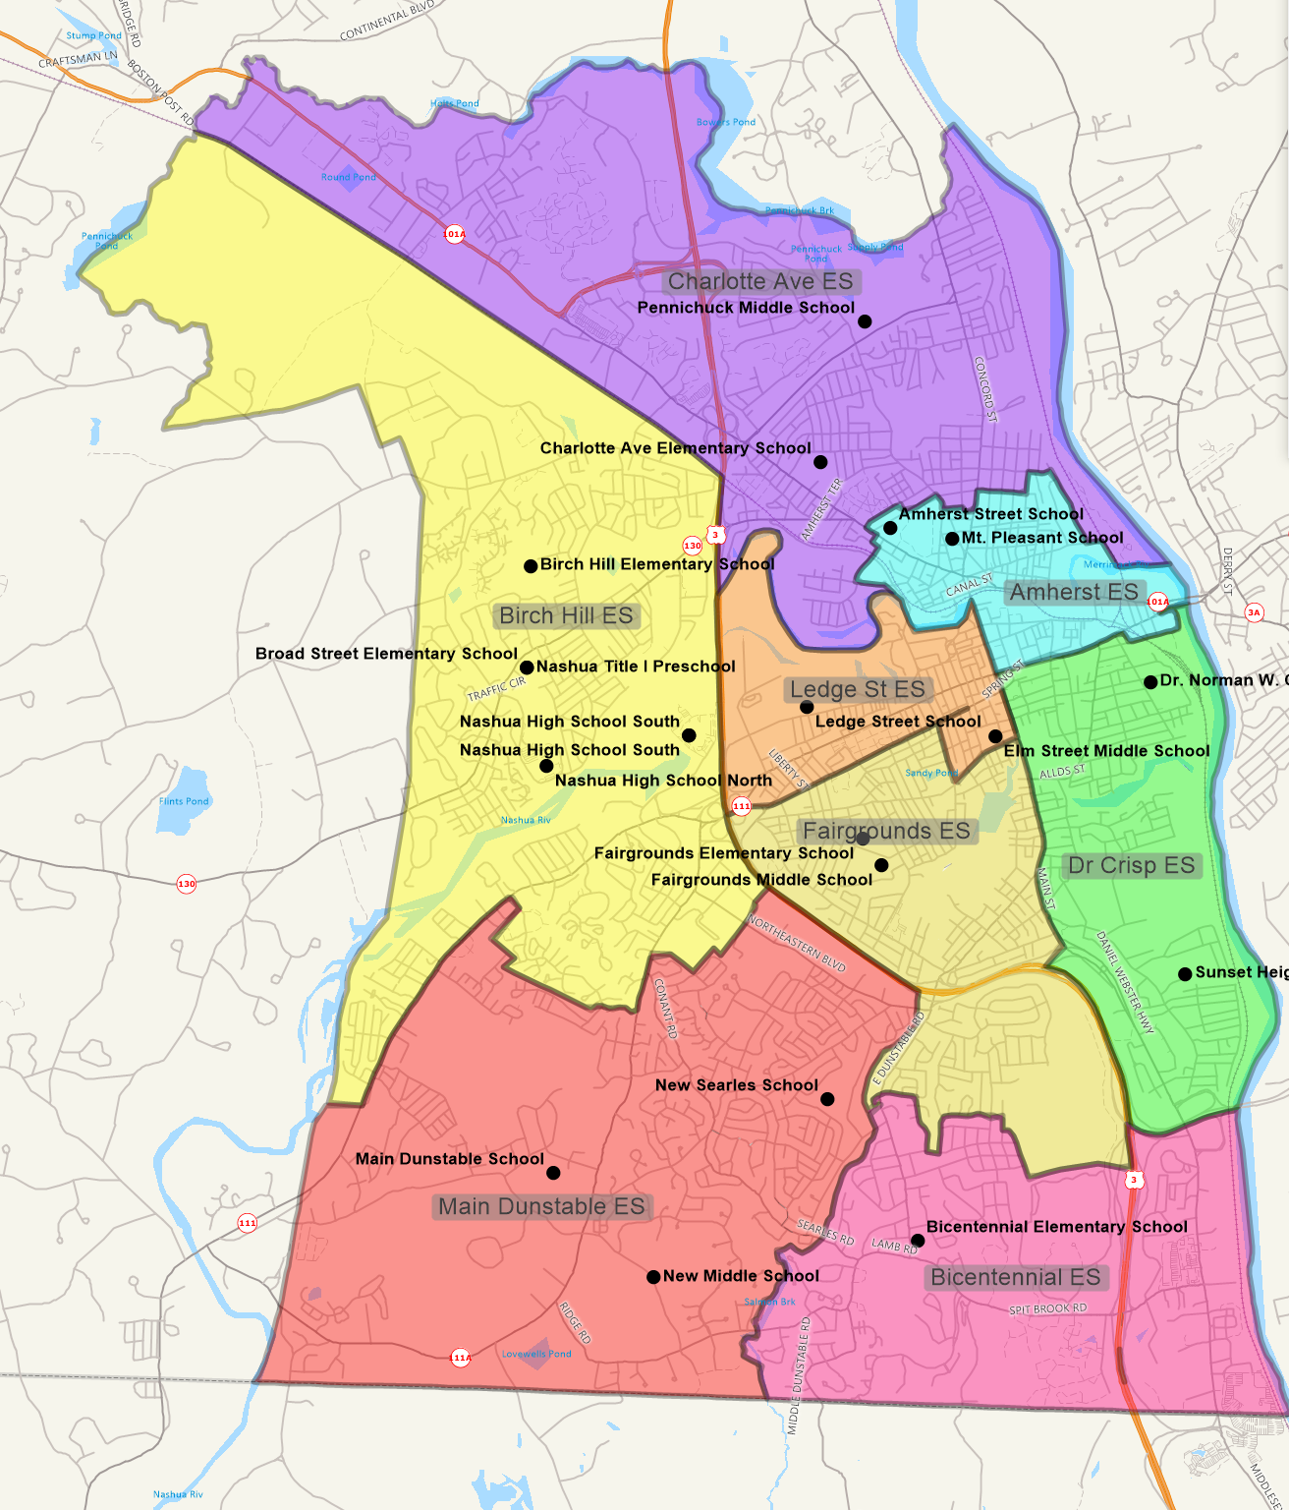
Key Findings
Here’s what the district looks like with 4 elementary schools closed

